Slide 1
Vendor C-CDA to FHIR mapping review and alignment

Slide 2
PAMPI Gaps Filling - Medications

Slide 3
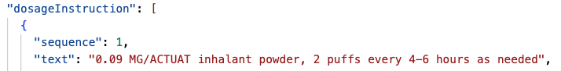
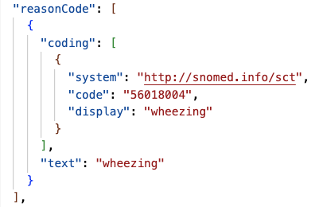
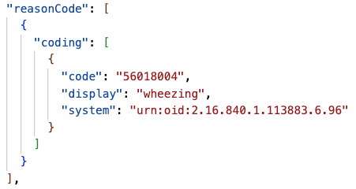
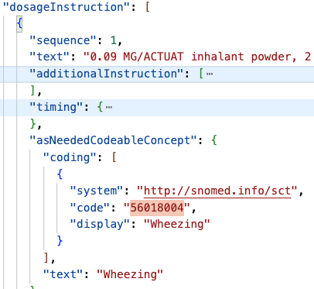
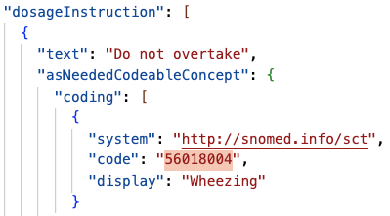
Sig
A
G
O
S
Indication
precondition

Slide 4
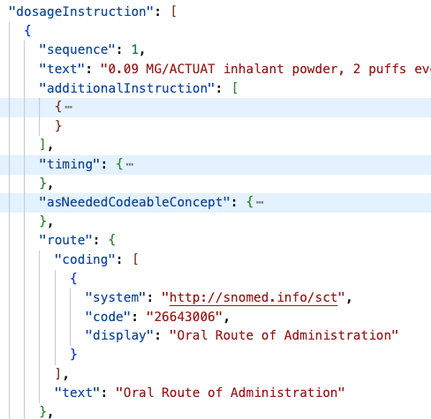
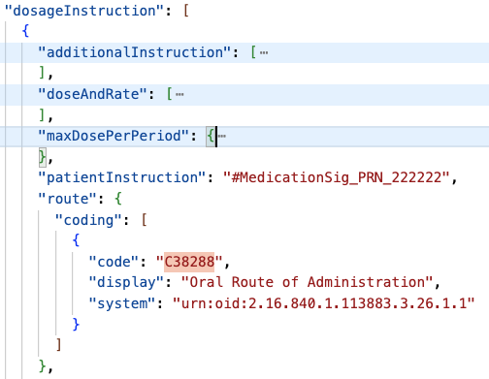
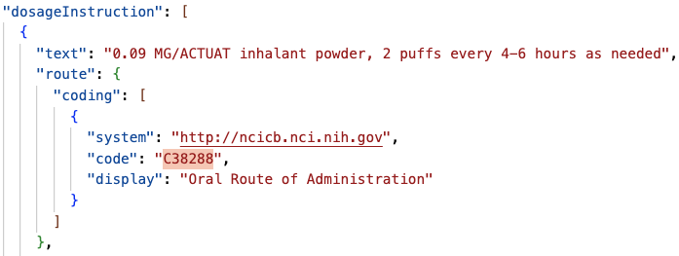
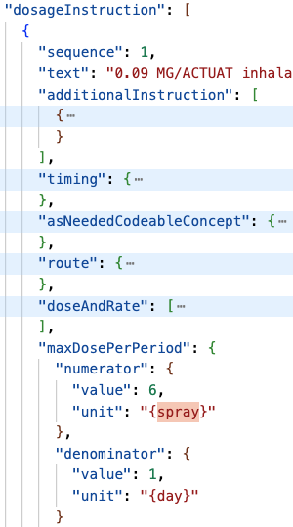
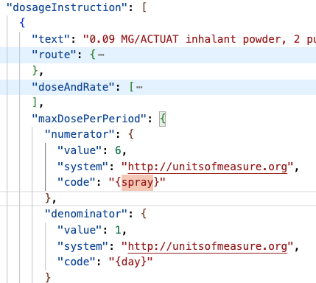
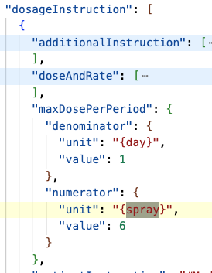
Route
G
O
S
get Smile’s system verify the URI
maxDoseQuantity
get all 4 attribute since it’s curly bracket

Slide 5
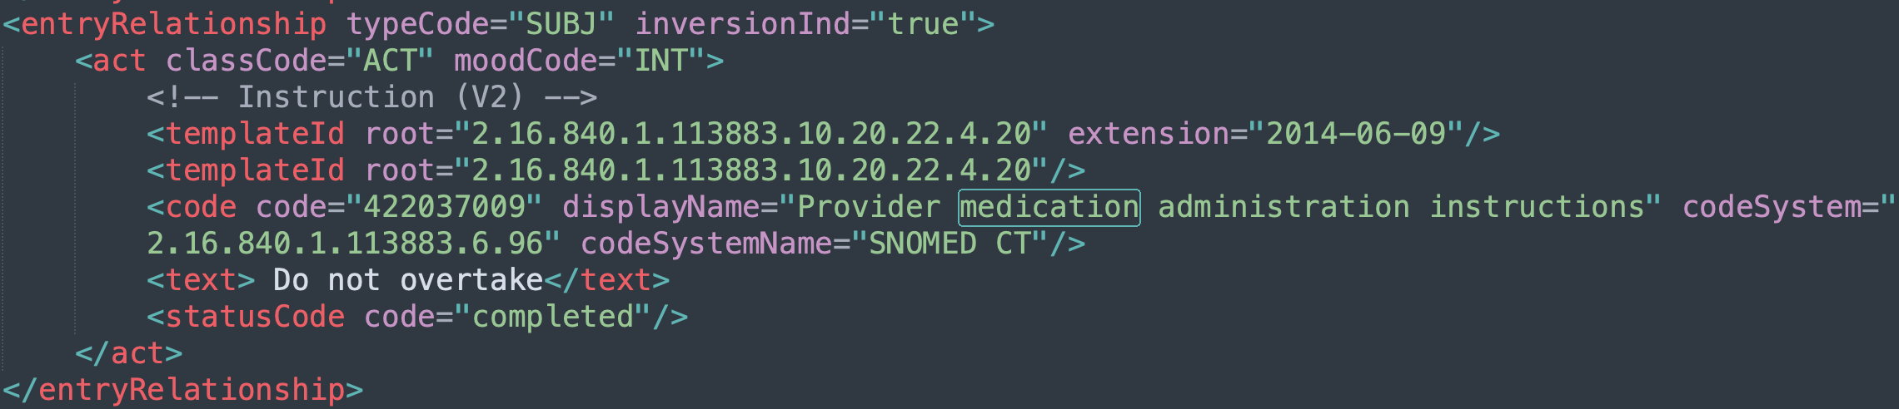
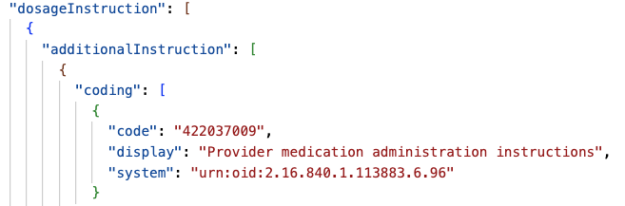
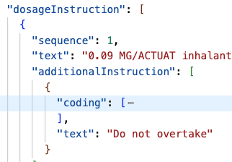
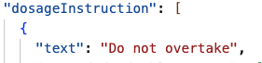
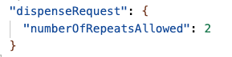
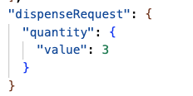
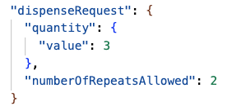
Instruction
A
G
M
O
S
Chun to change the example to be consistent with “do not overtake”; map the code to additionalInstruction, and text to patientInstruction
Supply (Dispense ER with an INT moodCode)
numberOfRepeat needs to be reduced by 1 when mapped to FHIR; only map when the dispense moodCode is INT as the meaning is different when the moodCode is EVN
Notes:
dispense: pharmacy hand over
administration: patient take the meds

Slide 6
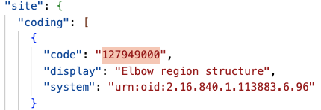
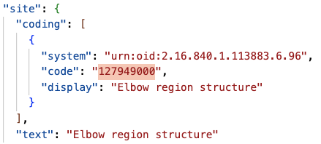
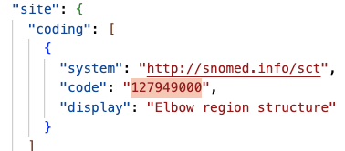
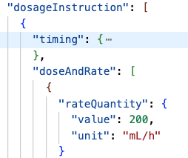
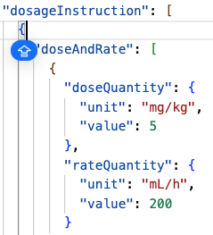
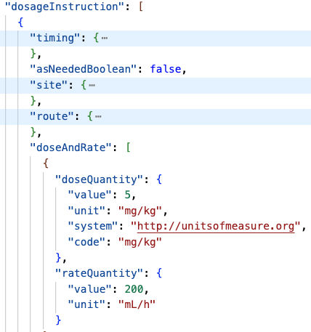
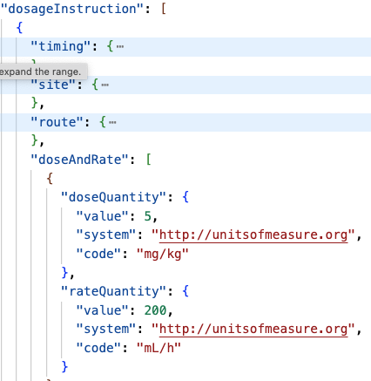
Site
A
G
M
O
S
Dose and Rate

Slide 7
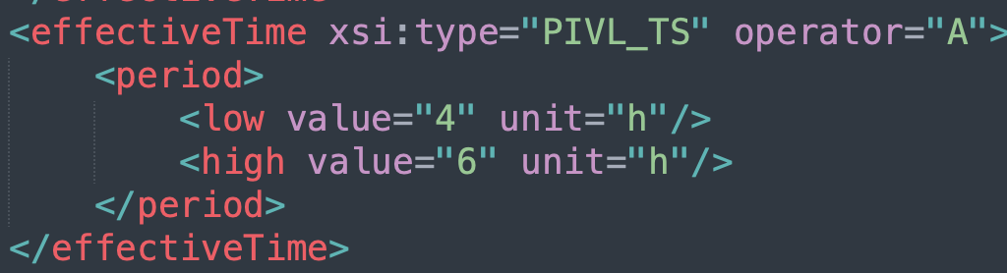
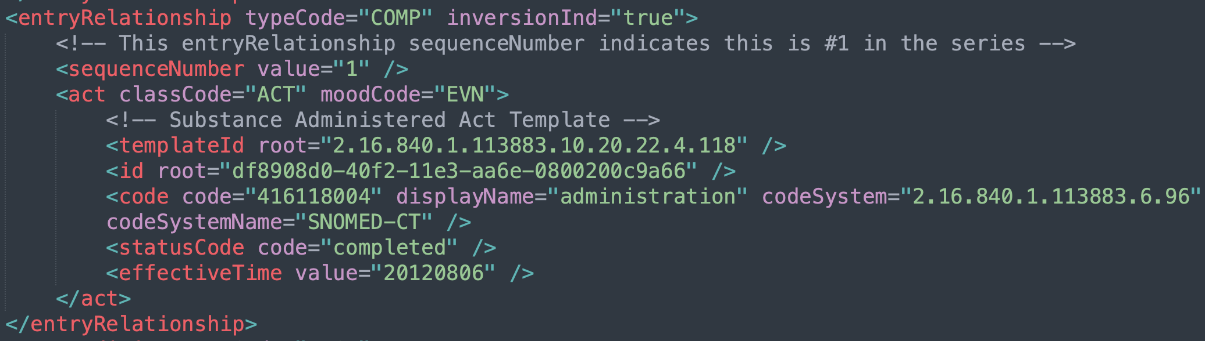
Attributes that no vendors have mapped - 1
The second timestamp
https://hl7.org/fhir/R4/datatypes.html#Timing
map to period, periodMax, periodUnit
administrationUnitCode – Ken /Benjamin
Substance Administered Act

Slide 8
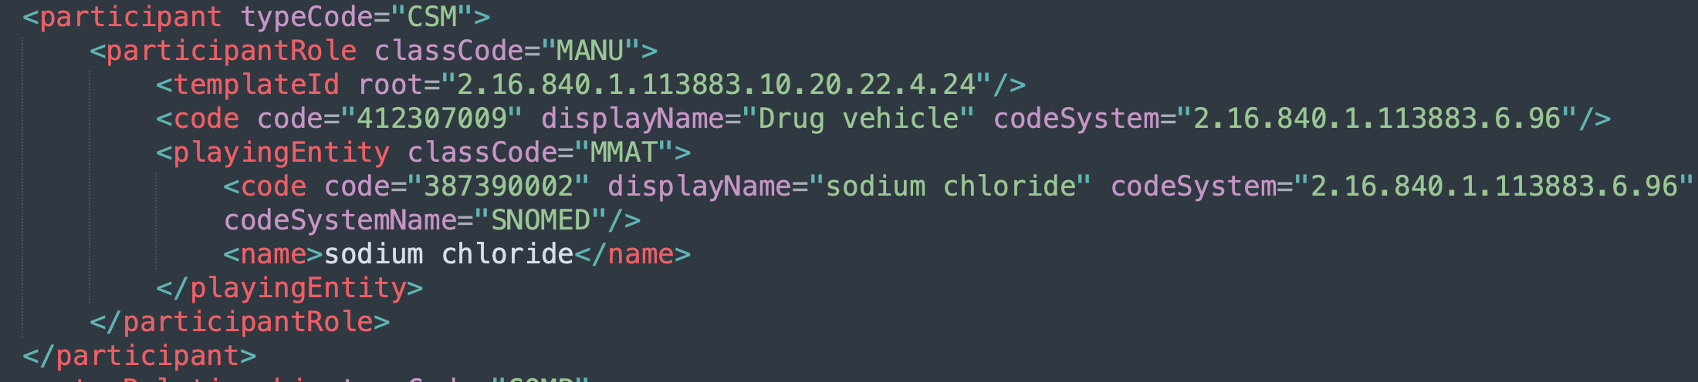
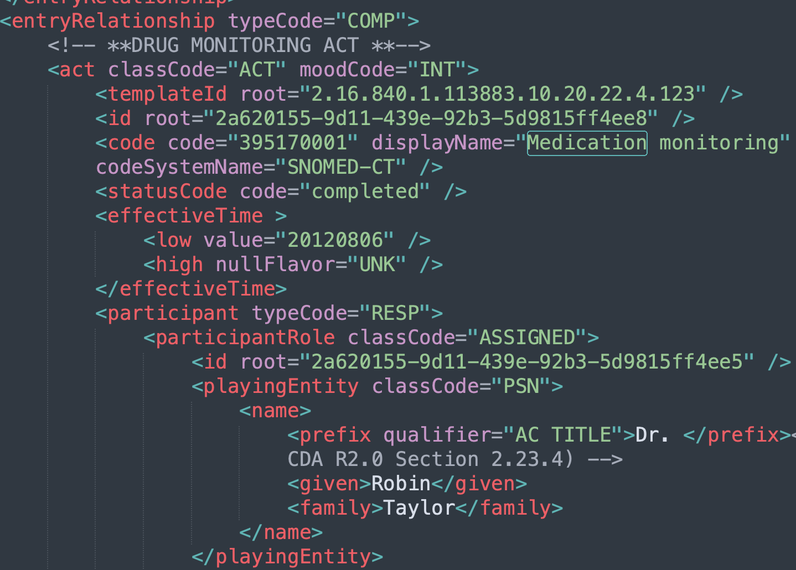
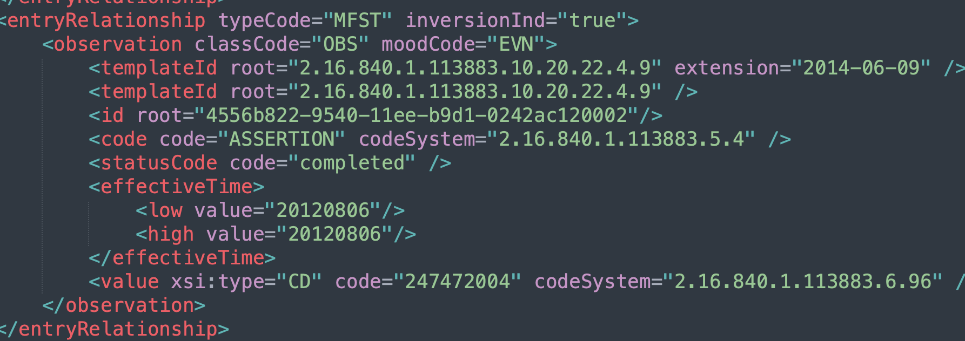
Attributes that no vendors have mapped - 2
Inconsistency between
Natalee to create a Jira to clarify
Drug Vehicle
Drug monitoring
Reaction

Slide 9
PAMPI Gaps Filling - Problems

Slide 10

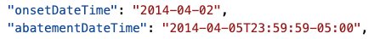
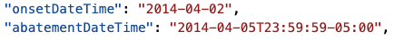
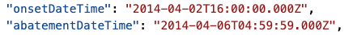
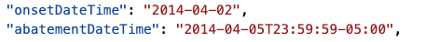
EffectiveTime high
A
G
M
O
S
condition 6

Slide 11
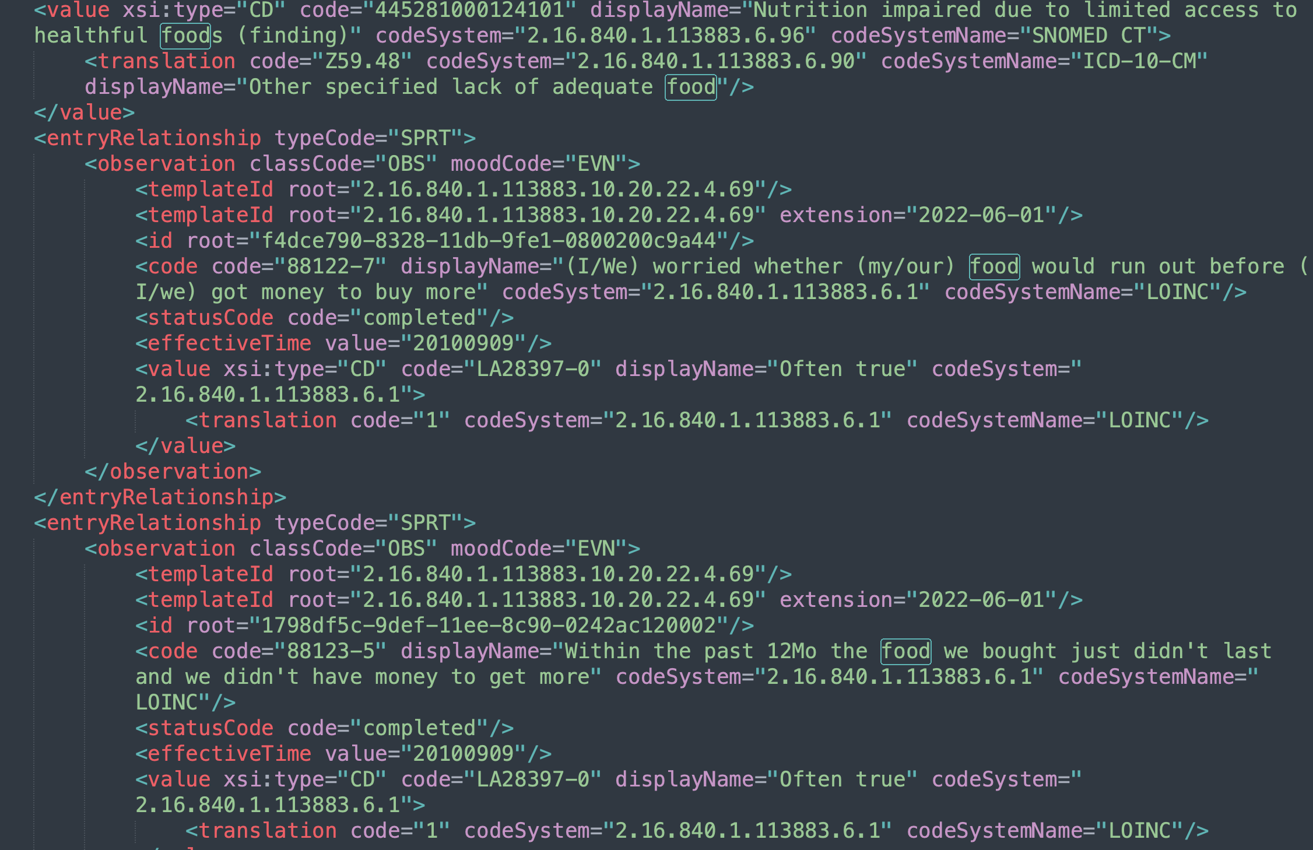
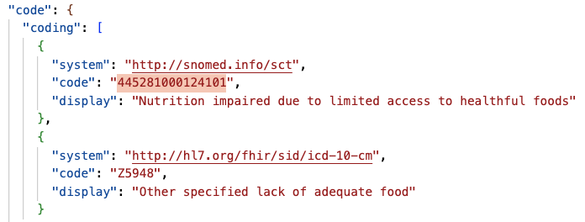
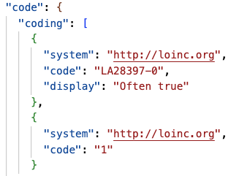
SDOH / Assessment Scale Obs
Most
map to https://www.hl7.org/fhir/us/core/screening-and-assessments.html#clinical-judgments. the main level code is the condition, and the ERs go into observations, which will be referenced in the evidence.detail. will not populate the evidence.code piece.
S

Slide 12
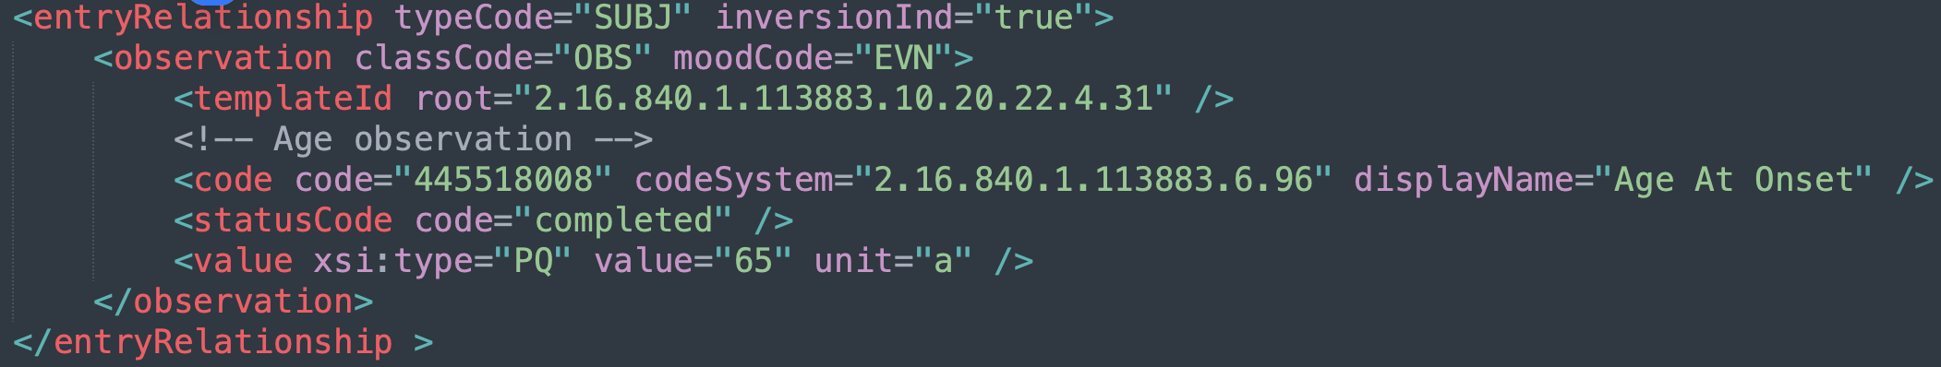
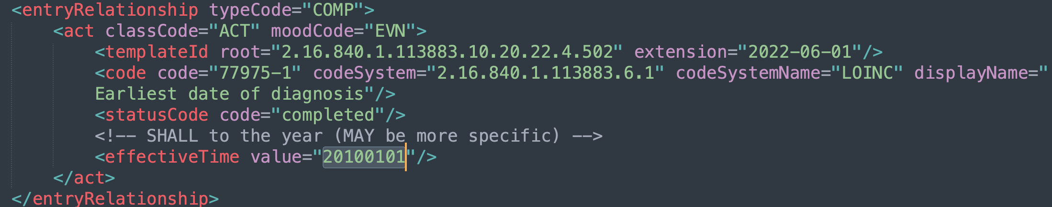
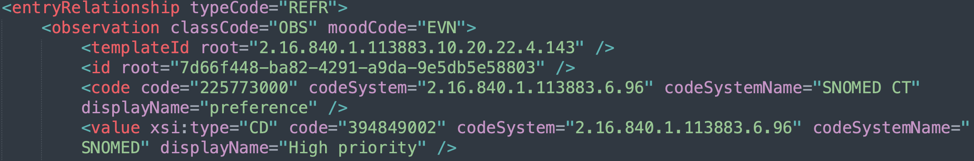
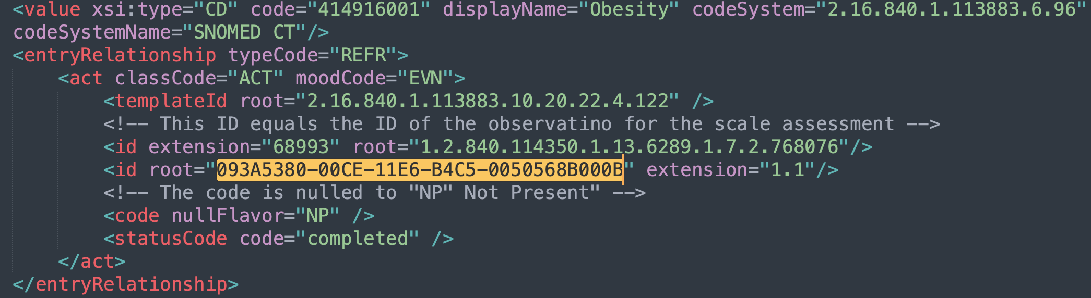
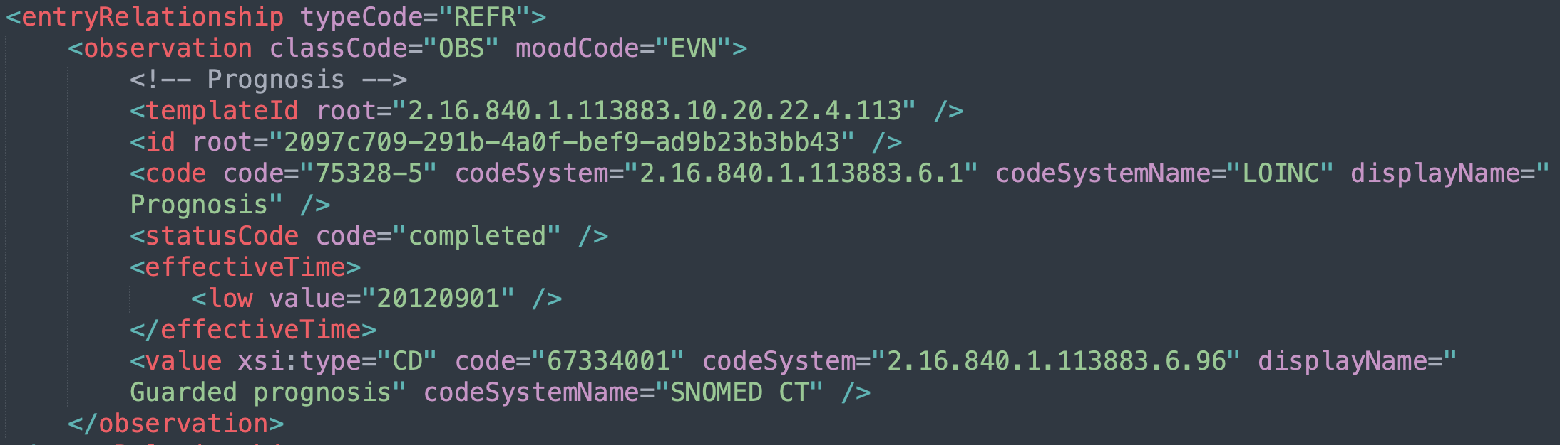
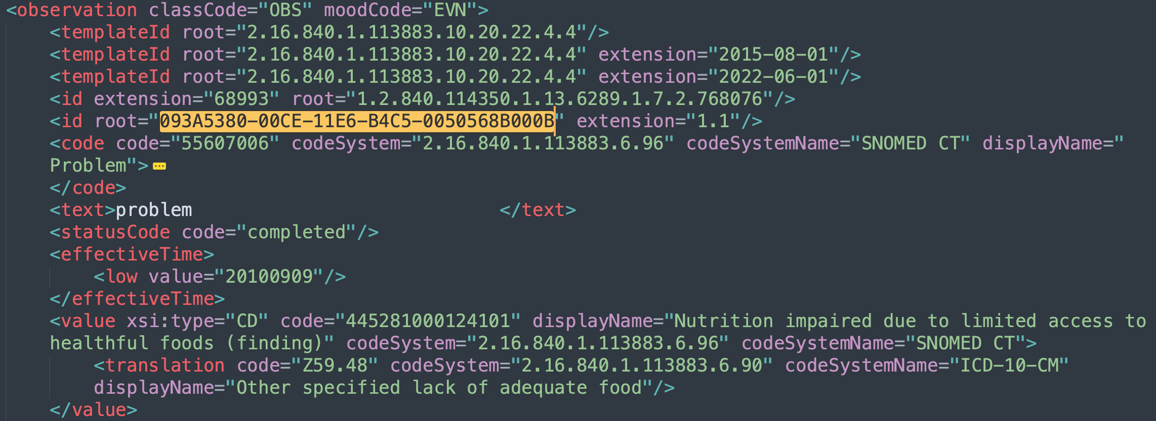
Attributes that no vendors have mapped
Age observation
Date of Diagnosis
map to the date extension
map to onsetAge; unless the onset time is populated, then just map the onset time
Priority (observation and act level)
Entry Reference [SPRT]
Definition was not clear esp for the one on the obs level; leave to the next round
Prognosis
resolve the reference to decide the resource to map; link the resource by map to evidence.detail
check with Jay; not an obvious way to map to FHIR; https://build.fhir.org/clinicalimpression.html

Slide 13
PAMPI Gaps Filling - Procedures

Slide 14
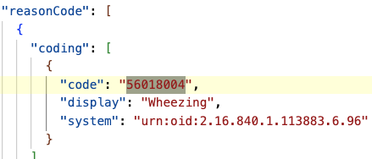
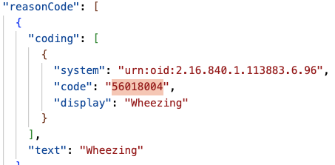
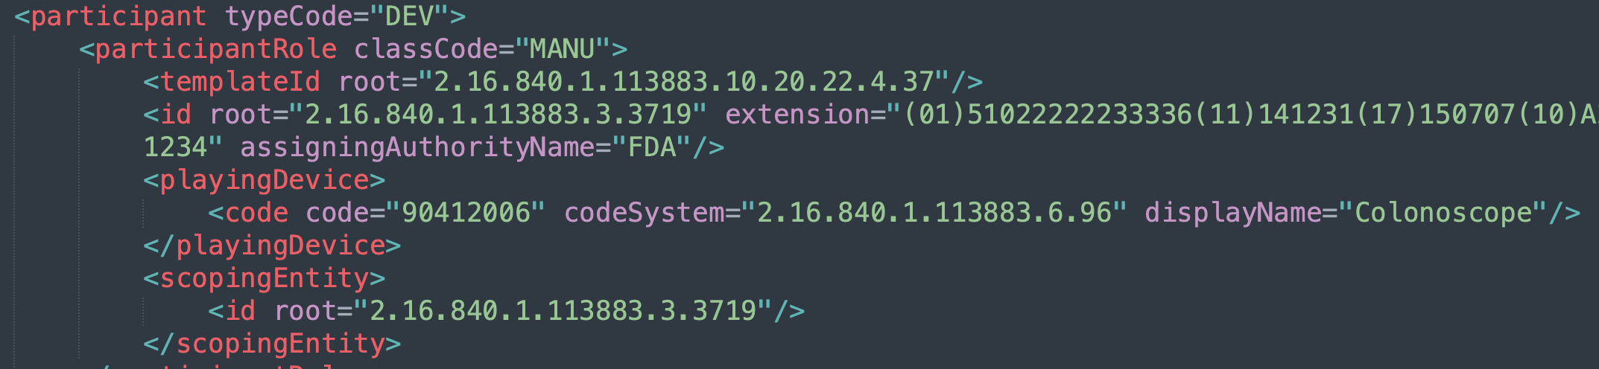
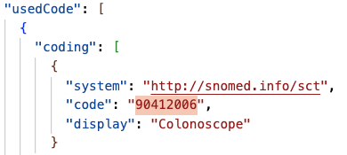
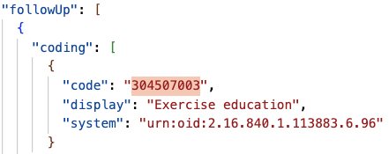
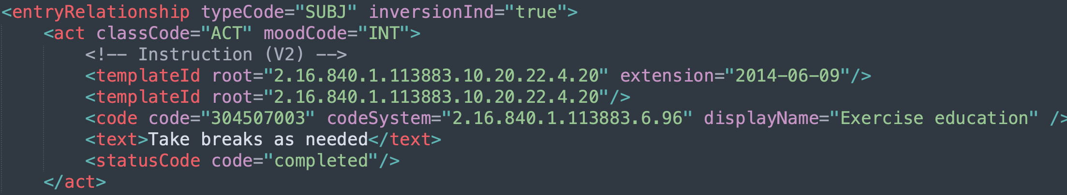
EffectiveTime →performedDateTime; one (S) mapped to performedPeriod.start
A
G
M
O
S
For low and high structure
if the same, map to performedDateTime;
else – map to performedPeriod
targetSiteCode→bodySite
Indication→reasonCode
Product Instance
Ben to follow up with SD
Instruction
Put in the bucket of not used, low impacted;
Ben to follow up with SD for possible deprecation/clarification?
Notes:
This clinical statement represents a particular device that was placed in a patient or used as part of a procedure or other act. This provides a record of the identifier and other details about the given product that was used. For example, it is important to have a record that indicates not just that a hip prostheses was placed in a patient but that it was a particular hip prostheses number with a unique identifier.

Slide 15
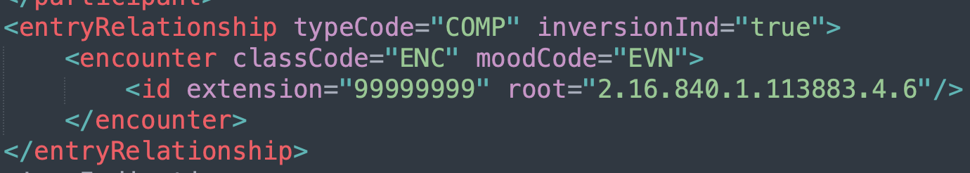

Attributes that no vendors have mapped - 1
Priority
Leave out
Method
Map to the extension
Encounter ER
resolve the ref link, map to an encounter resource, and refer to it
Specimen
Leave out for now – no way to structure it in FHIR;
Jay to ping relevant FHIR steward

Slide 16




Attributes that no vendors have mapped - 2
Medication Activity
Map to usedReference? (allow for Medication Resource)
Entry Reference
Reaction Obs

